Slide 1
Contents
Design Issues
Routing Algorithms
Internetworking
Network Layer of the Internet

Slide 2
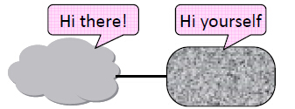

Internetworking
How do we connect different networks together?
– This is called internetworking
– We’ll look at how IP (Internet Protocol) does it

Slide 3
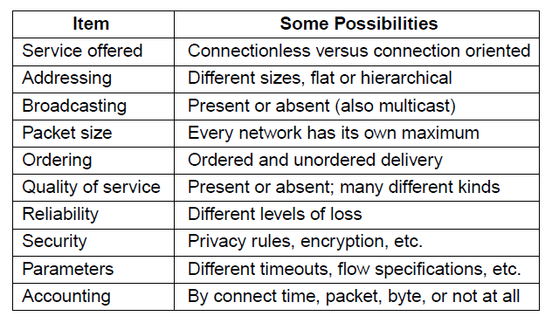
Internetworking
Differences can be large; complicates internetworking

Slide 4
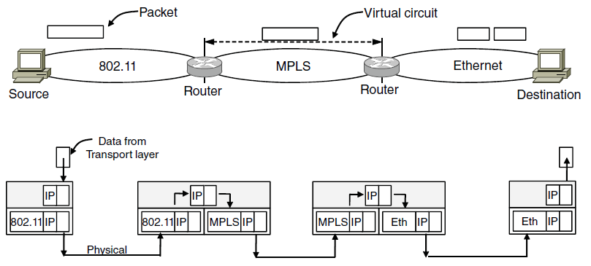
Internetworking
Internetworking based on a common network protocol – IP
Packet mapped to a VC here
Common protocol (IP) carried all the way

Slide 5
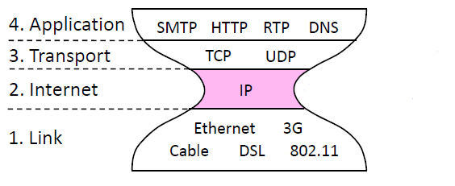
Internetworking
IP is the “narrow waist” of the Internet
– Supports many different links below and apps above

Slide 6
Internetworking
Suppose only some networks support QOS or security etc.
– Difficult for internetwork to support
Pushes IP to be a “lowest common denominator” protocol
– Asks little of lower-layer networks
– Gives little as a higher layer service

Slide 7
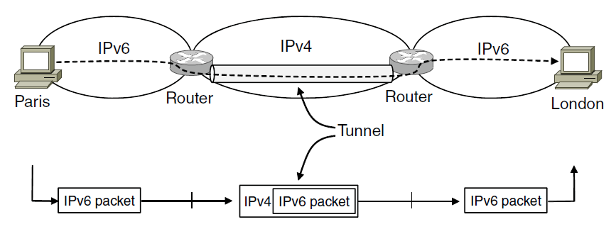
Internetworking
Connects two networks through a middle one
Packets are encapsulates over the middle

Slide 8
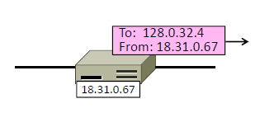
IPv4 (Internet Protocol)
What do IP addresses look like?
– And IP prefixes, or blocks of addresses
– (This is IPv4; we’ll cover IPv6 later.)

Slide 9
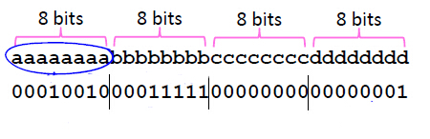
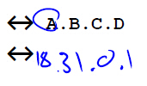
IPv4 (Internet Protocol)
IPv4 uses 32-bit addresses
– Later we’ll see IPv6, which uses 128-bit addresses
Written in “dotted quad” notation
– Four 8-bit numbers separated by dots

Slide 10
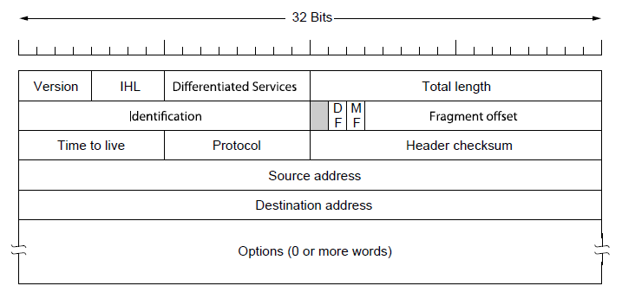
IPv4 (Internet Protocol)
Various fields to meet straightforward needs
Version, Header (IHL) and Total length, Protocol, and Header Checksum

Slide 11
IPv4 (Internet Protocol)
Network layer of the Internet, uses datagrams
– Provides a layer of addressing above link addresses (next)

Slide 12
IPv4 (Internet Protocol)
Some fields to handle packet size differences (later)
– Identification, Fragment offset, Fragment control bits

Slide 13
IPv4 (Internet Protocol)
Other fields to meet other needs (later, later)
– Differentiated Services, Time to live (TTL)

Slide 14
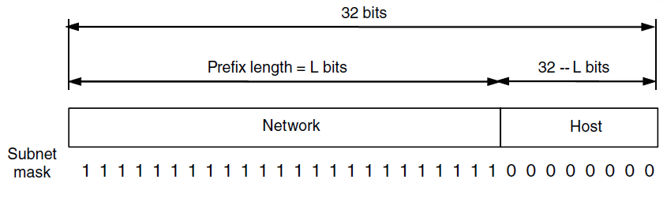
IP Prefixes-Modern
Addresses are allocated in blocks called prefixes
Addresses in an L-bit prefix have the same top L bits
Prefix is determined by the network portion
Has 2L addresses aligned on 2L boundary
Written address/length, e.g., 18.0.31.0/24

Slide 15




IP Prefixes-Modern
Written in “IP address/length” notation
– Address is lowest address in the prefix, length is prefix bits
– E.g., 128.13.0.0/16 is 128.13.0.0 to 128.13.255.255
– So a /24 (“slash 24”) is 256 addresses, and a /32 is one address

Slide 16
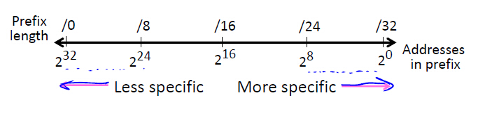
IP Prefixes-Modern
More specific prefix
Has longer prefix, hence a smaller number of IP addresses
Less specific prefix
Has shorter prefix, hence a larger number of IP addresses

Slide 17
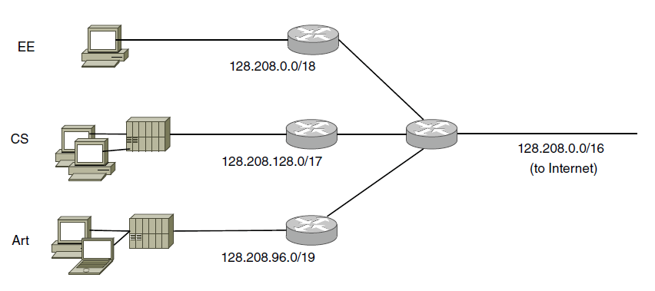
IP Addresses-Subnets
Subnetting splits up IP prefix to help with management
Looks like a single prefix outside the network
ISP gives network
a single prefix
Network divides it into subnets internally

Slide 18
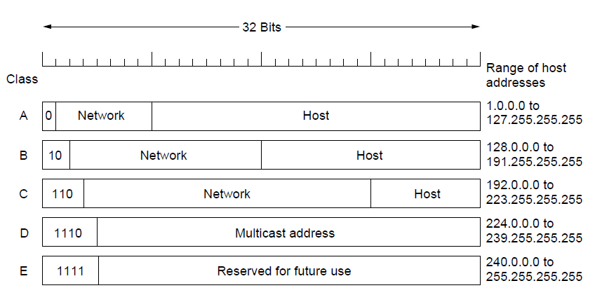
IP Addresses-Subnet Mask
For IPv4, a network is also characterized by its subnet mask
Subnet masks are also expressed in dot-decimal notation like an address.
For example, 255.255.255.0 is the network mask for the 192.168.1.0/24 prefix.
255.0.0.0
255.255.0.0
255.255.255.0

Slide 19
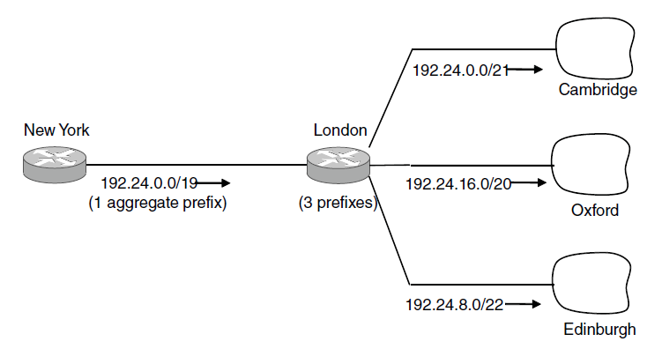
IP Addresses-Aggregation
Aggregation joins multiple IP prefixes into a single larger prefix to reduce routing table size
ISP advertises
a single prefix
ISP customers have different prefixes

Slide 20
IP Addresses
Originally, IP addresses came in fixed size blocks with the class/size encoded in the high-order bits
– They still do, but the classes are now ignored

Slide 21
Public/Private IP addresses
Public IP addresses, e.g., 18.31.0.1
– Valid destination on the global Internet
– Must be allocated to you before use
– Mostly exhausted … time for IPv6!
Private IP addresses
– Can be used freely within private networks (home, small company)
– 10.0.0.0/8, 172.16.0.0/12, 192.168.0.0/16
– Need public IP address(es) and NAT to connect to global Internet

Slide 22
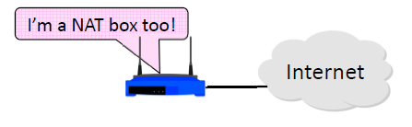
Network Address Translation
What is NAT (Network Address Translation)? How does it work?
– NAT is widely used at the edges of the network, e.g., homes

Slide 23
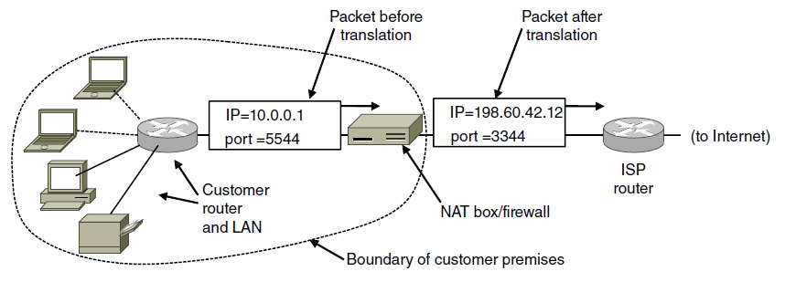
IP Addresses-NAT
NAT (Network Address Translation) box maps one external IP address to many internal IP addresses
Uses TCP/UDP port to tell connections apart
Violates layering; very common in homes, etc.

Slide 24
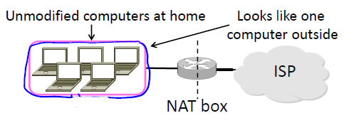
NAT
Common scenario:
Home computers use “private” IP addresses
NAT (in AP/firewall) connects home to ISP using a single external IP address

Slide 25
NAT
Keeps an internal/external table
– Typically uses IP address + TCP port
– This is address and port translation

Slide 26
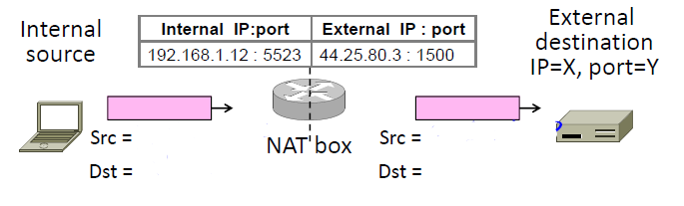
NAT
Internal to External:
– Look up and rewrite Source IP/port

Slide 27
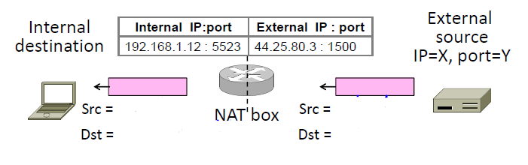
NAT
External to Internal:
– Look up and rewrite Destination IP/port

Slide 28
NAT
Downsides:
Connectivity has been broken!
– Can only send incoming packets after an outgoing connection is set up
– Difficult to run servers or peer-to-peer apps (Skype) at home
Doesn’t work so well when there are no connections (UDP apps)
Breaks apps that unwisely expose their IP addresses (FTP)

Slide 29
NAT
Upsides:
Relieves much IP address pressure
– Many home hosts behind NATs
Easy to deploy
– Rapidly, and by you alone
Useful functionality
– Firewall, helps with privacy
Kinks will get worked out eventually
– “NAT Traversal” for incoming traffic

Slide 30
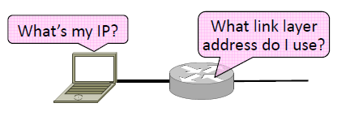
ARP and DHCP
Filling in the gaps we need to make for IP forwarding work in practice
– Getting IP addresses (DHCP) ?
– Mapping IP to link addresses (ARP) ?

Slide 31
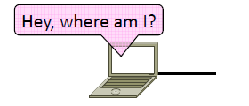
Getting IP Address
Problem:
– A node wakes up for the first time …
– What is its IP address? What’s the IP address of its router? Etc.
– At least Ethernet address is on NIC

Slide 32
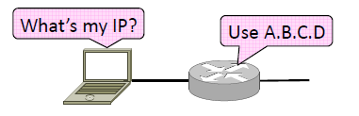
Getting IP Address
1. Manual configuration (old days)
– Can’t be factory set, depends on use
2. A protocol for automatically configuring addresses (DHCP) ?
– Shifts burden from users to IT folk

Slide 33
DHCP
DHCP (Dynamic Host Configuration Protocol), from 1993, widely used
It leases IP address to nodes
Provides other parameters too
– Network prefix
– Address of local router
– DNS server, time server, etc.

Slide 34
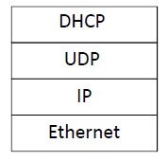
DHCP
DHCP Protocol Stack
DHCP is a client-server application
– Uses UDP ports 67, 68

Slide 35
DHCP
Bootstrap issue:
– How does node send a message to DHCP server before it is configured?
Answer:
– Node sends broadcast messages that delivered to all nodes on the network
– Broadcast address is all 1s
– IP (32 bit): 255.255.255.255
– Ethernet (48 bit): ff:ff:ff:ff:ff:ff

Slide 36
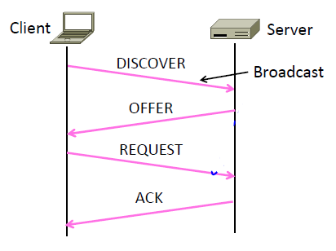
DHCP

Slide 37
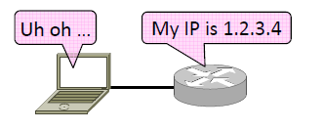
Sending an IP Packet
Problem:
– A node needs Link layer addresses to send a frame over the local link
– How does it get the destination link address from a destination IP address?

